Slide 1
PHISHING WEBSITE AND SPAM-EMAIL DETECTION USING RANDOM FOREST ALGORITHM

Slide 2
PHISHING:
Phishing is a cybercrime in which a target or targets are contacted by email, telephone or text message by someone posing as a legitimate institution to lure individuals into providing sensitive data such as personally identifiable information, banking and credit card details, and passwords.
The information is then used to access important accounts and can result in identity theft and financial loss.

Slide 3
TYPES OF PHISHING:
EMAIL
PHARMING
WEBSITE
HTTPS
SPEAR
WHALING
ANGLER

Slide 4
WEBSITE PHISHING:
Website phishing refers to the cyber crime where the attacker uses a URL link to make his attack successful.
These URL links look like they are genuine which can fool anyone who clicks on that link with the intention of browsing it.
Those links try to extract the addresses and other important credentials of the victim in order to cause harm in one way or another.
Also, these links can add malicious code to the system giving the attacker, access to an individuals system.

Slide 5
The main victims of website phishing are mainly the youngsters.
During the teenage years, there are a lot of changes going on in those physically and mentally.
Anything which seems attractive, they tend to go towards it without considering it’s aftermaths.
They don’t have self control when it comes to these type of things.
Those websites look so eye catching to those kids, they can’t resist.
Even if they know that it is a phishing website, they click on it ignorantly.
This is the main reason for phishing links to be so common and difficult to control.

Slide 6
Not all those phishing links are explicit content.
Many of them also act as an e-commerce website too.
They try to sell items on a low prices. This leads to victims releasing their sensitive information like address, phone numbers and even the bank credentials.
At the time it looks genuine to the people, which in reality is nothing but open theft.

Slide 7
WAYS TO PREVENT IT:
The most important thing here to do is to teach the people on how to avoid them.
They should be taught not to click on any links which may seem fraud.
They should never trust the advertisement pop-ups on the screen, which when clicked on is the start of phishing.
The children should avoid watching of explicit content as something to enjoy. Explicit content with added e-commerce is very common on those sites.
If anyone wants to click on any link, but is suspicious of it, they can use our website and be sure if clicking on that link would cause harm or not.

Slide 8
EMAIL PHISHING:
Email phishing is one of the most common type of phishing which has caused great harm to the victims both mentally and financially.
Messages like:
“You have won the lottery of 1 Cr. Give us your bank details and enjoy the lottery money.”
These messages are fraud and one should not fall for it, but seeing the price money like 1 Cr, people can’t resist.
Not only this, but also phishing links can also be sent through mails.

Slide 9
WAYS TO PREVENT IT:
Again, people should be educated about all of these.
There are a lot of spam emails which are clear and they should be unsubscribed if did, or delete and block the sender’s email and put them to spam.
If anyone is interested in them, mail which is related to their interests but seems suspicious, they can use our website to confirm if it would be smart to click on those messages.

Slide 10
WHY MACHINE LEARNING?
Machine learning (ML) is a type of artificial intelligence (AI) that allows software applications to become more accurate at predicting outcomes without being explicitly programmed to do so.
Machine learning algorithms use historical data as input to predict new output values.

Slide 11
RANDOM FOREST ALGORITHM
Random Forest is a popular machine learning algorithm that belongs to the supervised learning technique.
It can be used for both Classification and Regression problems in ML.
It is based on the concept of ensemble learning, which is a process of combining multiple classifiers to solve a complex problem and to improve the performance of the model.
Random Forest is a classifier that contains a number of decision trees on various subsets of the given dataset and takes the average to improve the predictive accuracy of that dataset.

Slide 12
OBJECTIVE:
Phishing was the most common type of cybercrime in 2020 and is scarcely
easy to do.
'Spam email and phishing detection website' is a user friendly website that aims to detect spam emails and phishing links with the help of Random Forest algorithm.

Slide 13
OVERALL SYSTEM ARCHITECTURE DIAGRAM:
TWO SEPARATE WEB PAGE FOR PHISHING LINK AND SPAM EMAIL DETECTION
USER GIVES INPUT IN THE GIVEN TEXT BOX
TRAINED RANDOM FOREST ALGORITHM WILL EVALUATE THE INPUT
FOR GIVEN LINK, RESULT WILL BE -
PHISHING or SAFE
FOR EMAIL, RESULT WILL BE-
SPAM or SAFE

Slide 14
FLOW DIAGRAM:
DATASET COLLECTION OF PHISHING WEBSITE AND SPAM EMAIL
FEATURE EXTRACTION
TRAINING RANDOM FOREST ALGORITHM
IMPLEMENTING THE ALGORITHM IN OUR WEBSITE
TESTING IT ON DATABASE

Slide 15
FRONT END CODE

Slide 16
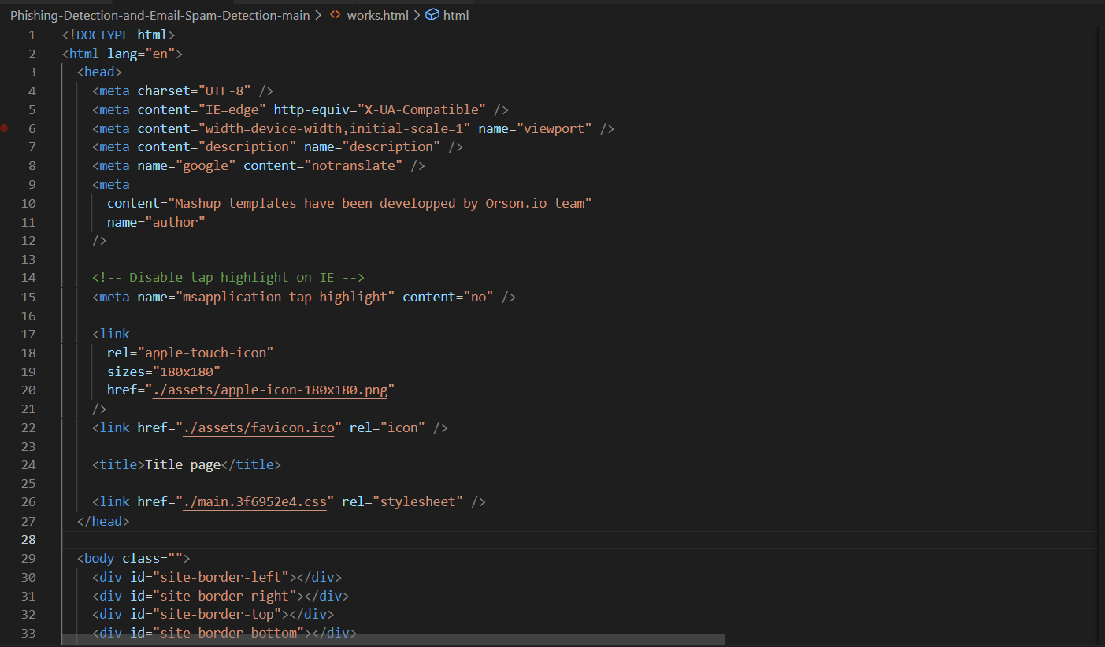

Slide 17
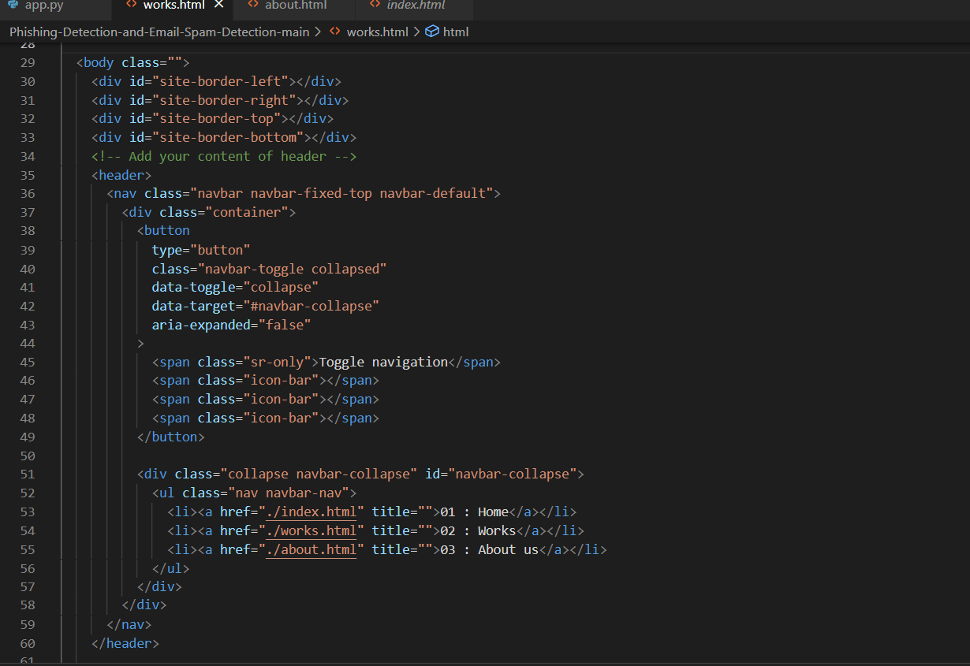

Slide 18
BACK END CODE

Slide 19
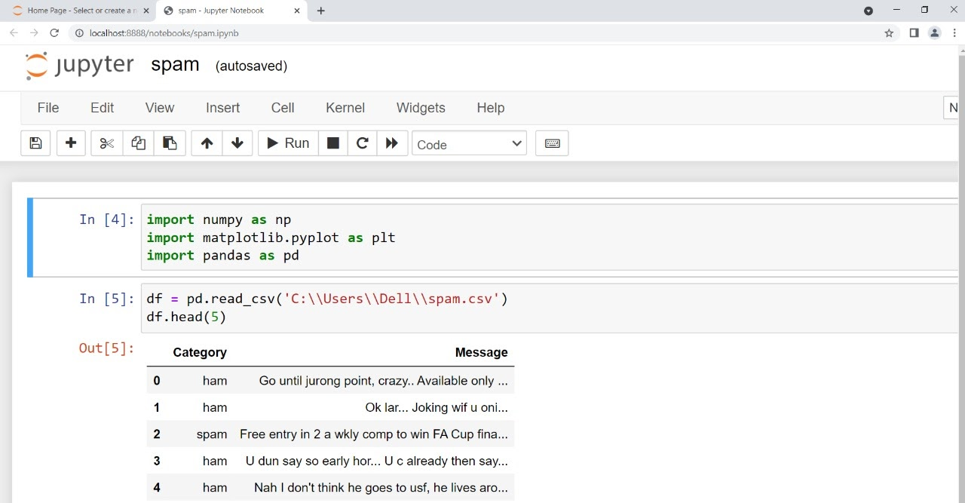
Implementation Screenshot

Slide 20
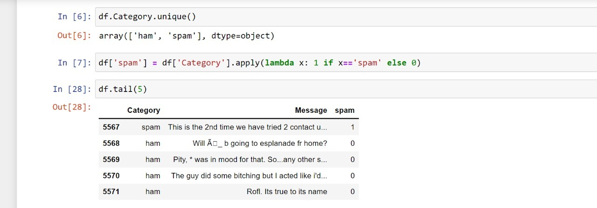

Slide 21
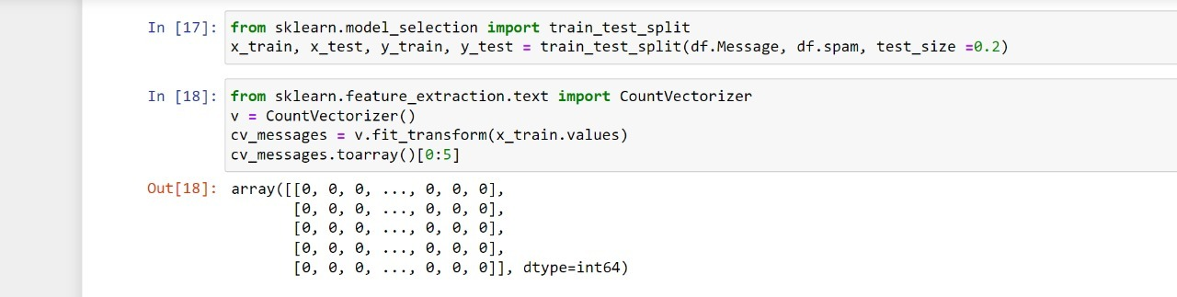

Slide 22
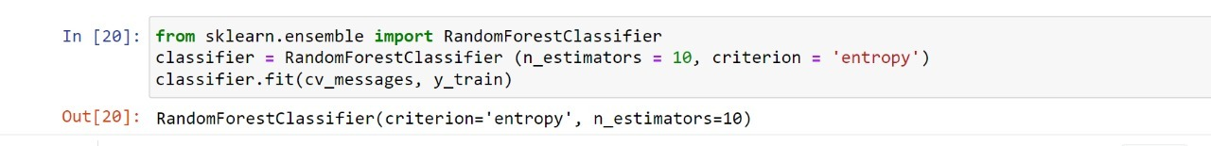
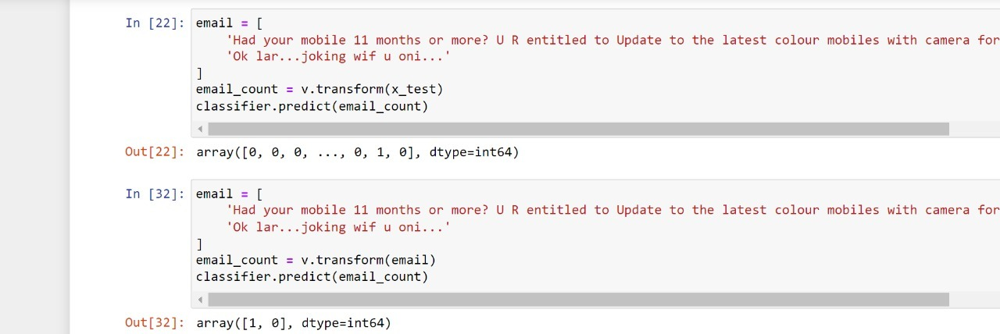

Slide 24
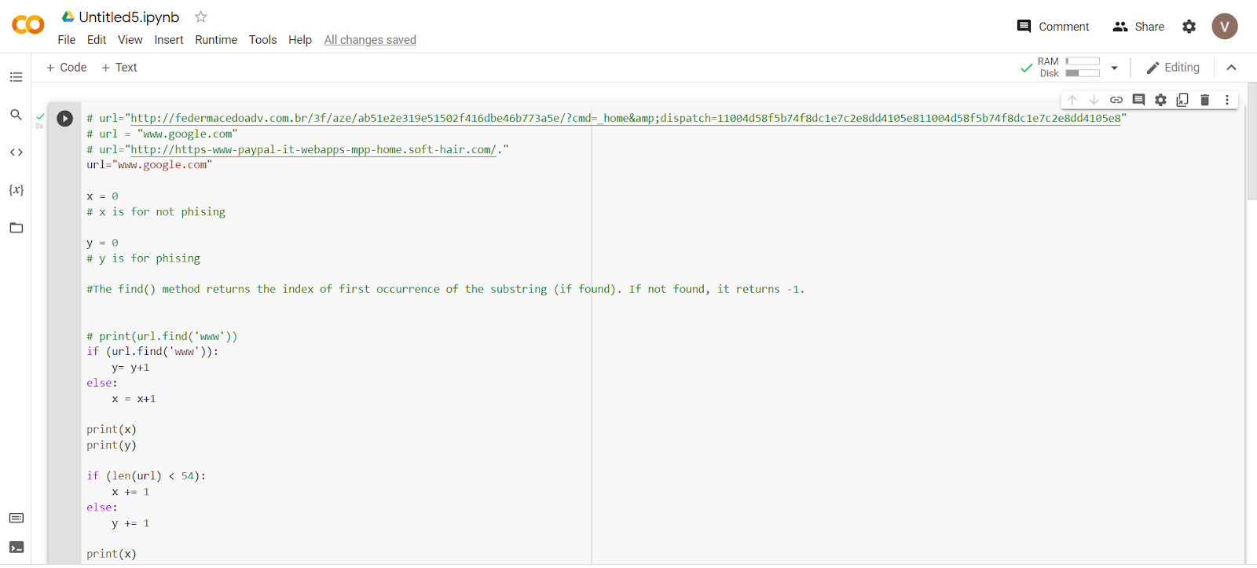
PHISHING

Slide 25
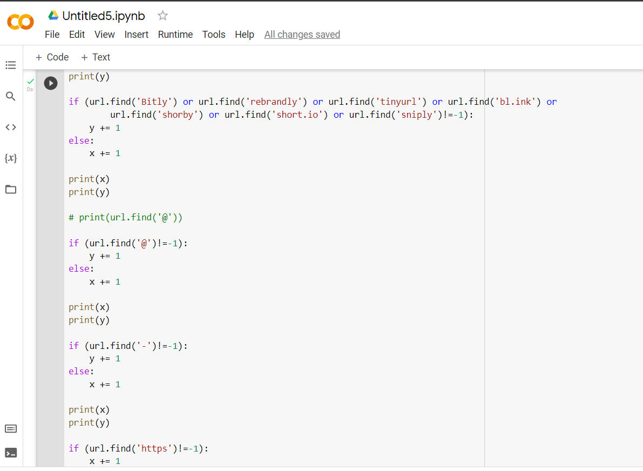

Slide 26
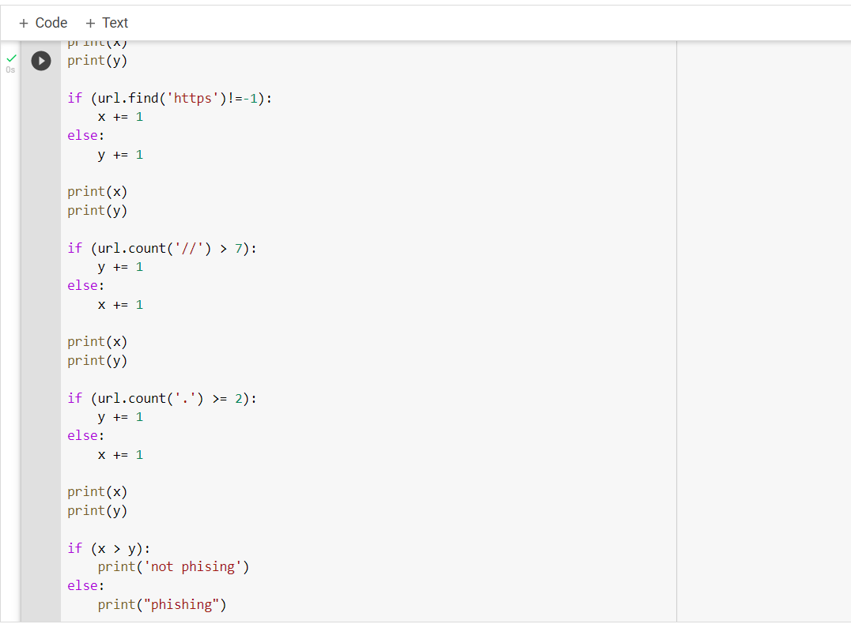

Slide 27
Thank You

